Slide 1

The Ontology of Contemporary Education
  Andrey Reus,
  Bangalore, February 14, 2025

Slide 2



The trajectory of a person's life cycle in the educational universum
Individual trajectory
Perception of oneself as an actor
Perception of oneself as a human being
2
3
Supporting individual trajectory
Environment
Methodical Workshop
1
Pedagogical workshop
Methodological Workshop
Pure potential
Appendix №. 1

Slide 3
The notion of a human
Ideology
Self-reflection as
an actor
Moral law
Intelligence
Will
Appendix №. 2

Slide 4

The notion of ideology. (should be corrected)
Culture and art
Private property and business
Faith
History
Logos (world mind)
Appendix №. 3

Slide 5
The notion of intelligence
Understanding
Reflection
Mental process
(Thinking)*
Thinking-Activity*
Thinking-Communication*
Appendix №. 4

Slide 6


The model of the «maternity» school
Space of
situations
Intellectual function development
Feelings cultivation
Introduction to the world of culture and art
Physical education
Pedagogical workshop
Construction of situations
Appendix №. 5

Slide 7
The model of a contemporary school
The School of Musk
Space of self-determination in activity
Space of access to life
Logos (world mind)
The School of Pythagoras
Intellectual functions
Environment for enlightenment
Communication and activity core
Communication and game core
Health-construction
Literacy
Digital literacy
Culture and art
……
Languages
Finance
Project Management
Law, regulations
Ecology
Practical training
Projects
Competitions
Practices
Olympiads
Subjects
WorldSkills
Workshops
Games
Community of educators and parents
Science and Education
Art and Culture
Business
Authority
Health-construction
Public organizations
Pedagogical workshop: Technologies and methodics
Appendix №. 6

Slide 8



The WorldSkills model
5
1
Technical description of WS competency as an activity
Analytics, design, methodical work
4
3
Evaluation in WS standard-based events (championships, DE)
System of exercises and training that allows mastering the activity
2
Basic skills
Appendix №. 7

Slide 9
The model of contemporary higher education
«Exchange Market» space (quotation)
Course navigator
«Logos (world mind)»
Space of ideas, thoughts, knowledge
Quotation of courses
Quotation of individual trajectories (actually human and competence)
...
teaching community
Communication and activity core
Contest navigator
Process of disembedding of subjects
(disubjectivation)
Contests
Projects
Mastering of WorldSkills competences
WorldSkills navigator
Process of re-embedding of subjects (resubjectivation)
Method of emergence and creation of
new knowledge
Research
Practices and internship
Practices and internship navigator
…
Society
product and result of the activity
Appendix №. 8

Slide 10
The model of a corporate university
1. International practices (best practices)
Forms of knowledge packaging
AI tools
Navigation and analytics
2. Communication and activity core
Strategy
Own corporate knowledge
1
2
Practical tasks on implementation of the strategy
No.
3. Implementation machines
Appendix №. 9

Slide 11
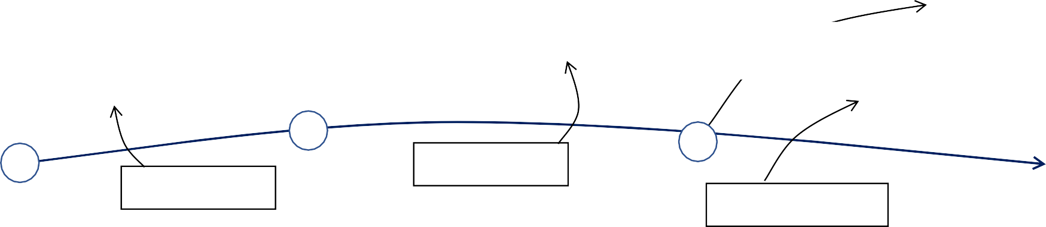






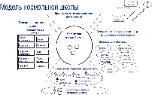
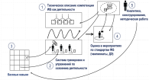
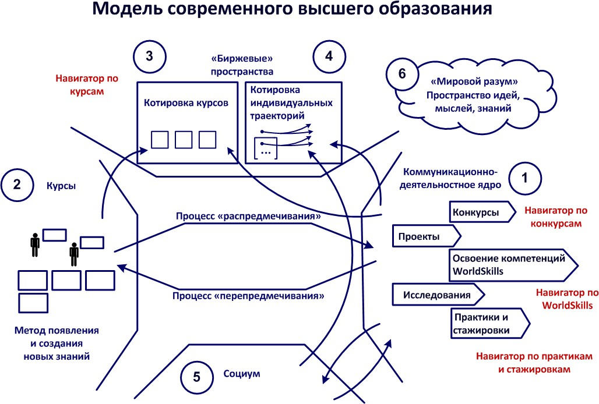
Ontology of contemporary education (schematosaurus)
Individual trajectory
Educational Universum
Perception of oneself as a human being
2
Perception of oneself as an actor
Supporting
individual
trajectory
Environment
3
1
Pure
potential
Methodical
workshop
Pedagogical workshop
Methodological Workshop
1
Educational workshop
2
3
4
5
1. Мировой опыт
Формы упаковки знаний
Инструменты ИИ
2. Коммуникационно-деятельностное ядро ^{Навигация и}
Вхождение в мир культуры и
искусства
Решение
педагогических задач
Становление
интеллектуальных функций
Стратегия
аналитика
Собственные корпоративные знания
1
Практические задачи по реализации стратегии
2
N
Воспитание чувств
Пространство
^{ситуаций} Воспитание тела и воли
Привычные
социальные навыки
3. Реализационные машины
Kindergarten - Elementary School
Secondary school
WorldSkills
Higher education
Corporate
university
Unified technological framework
Management training based on practical tasks
Development of intellectual functions
Engaging in art and culture
The organization of work with artificial intelligence
Engineering training and technical creativity.
Physical education, languages education
WorldSkills
Appendix №. 10

Slide 12




Practical training
3. Post-action review, comparing what has been achieved with what was planned, evaluation of one's actions, products and results obtained
1. Goal-setting and planning of one's actions (including the products, results and consequences of one's actions)
Practical training is based on the concept of practice and includes 3 indispensable elements
2. The actual practice in compliance with the set goals and objectives
Appendix №. 11

Slide 13
THANK YOU FOR YOUR ATTENTION!

